Slide 1

Basic Details of the Team and Problem Statement
Ministry/Organization Name/Student Innovation: ISRO
PS Code: SS596
Problem Statement Title: Water Quality from Mobile captured and Google earth images
Team Name: Sophomores
Team Leader Name: Priyanshu Choudhary
Institute Code: U-0348
Institute Name: Sant Longowal Institute of Engg. and Tech.
Theme Name: Disaster Management

Slide 2
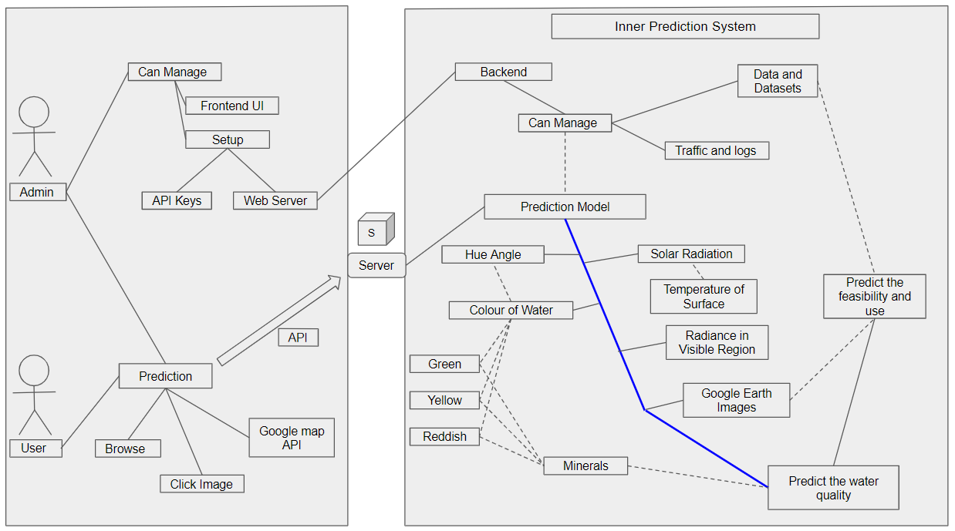
Idea/Approach Details
Describe your idea/Solution/Prototype here:
The idea is to develop an automatic prediction system which will predict the quality of water based on the colour of water, solar radiation, hue angle and radiance in visible region.
This prediction system’s working is based on image processing using computer vision, it will predict the quality of water by processing the image of that water.
Model will use Sentinel satellite for getting proper parameters to calculate the output.
In future, ISRO can replace Sentinel with it’s highly supervised satellites for more accurate results.
This idea is flexible as we can use both web application or android application.
Describe your Technology stack here:
Web Server : Apache
Programming Languages : Java and Python
Frameworks : React Native, Django
APIs : Google Earth APIs, Sentinel2, etc.
Operating System : Linux/Windows

Slide 3
Idea/Approach Details
Describe your Dependencies / Show stopper here
Describe your Use Cases here
User will click the image of water for which quality has to be predicted or select from provided map interface.
User will upload the image using android application.
Image will be processed to backend using API call.
Image will be transferred to prediction model.
Prediction system will predict the quality of water using various parameters like:
i. Colour of Water ii. Hue angle
iii. Solar Radiation iv. Radiance
The prediction will be based on the Computer Vision and Machine Learning.
The result will be received using the API.
Then the application will display the most probable results.
Will be good if organization provides dataset to train model.
Water should be clear in the images clicked by mobile to get more accurate output.
Image must be clicked for a large source of water like pond, lake or sea as the problem is based on disaster management domain.
For Google Maps input, non-cloudy images will be preferred to avoid messing of water and cloud colors.

Slide 4
Team Member Details
Team Leader Name: Priyanshu Choudhary
Branch (Btech/Mtech/PhD etc): Btech Stream (ECE, CSE etc): ECE Year (I,II,III,IV): II
Team Member 1 Name: Abdul Rehman
Branch (Btech/Mtech/PhD etc): Btech Stream (ECE, CSE etc): CSE Year (I,II,III,IV): II
Team Member 2 Name: Angad
Branch (Btech/Mtech/PhD etc): Btech Stream (ECE, CSE etc): CSE Year (I,II,III,IV): II
Team Member 3 Name: Anurag Tiwari
Branch (Btech/Mtech/PhD etc): Btech Stream (ECE, CSE etc): ECE Year (I,II,III,IV): II
Team Member 4 Name: Prachi Sinha
Branch (Btech/Mtech/PhD etc): Btech Stream (ECE, CSE etc): CSE Year (I,II,III,IV): II
Team Member 5 Name: Subham Raj
Branch (Btech/Mtech/PhD etc): Btech Stream (ECE, CSE etc): ECE Year (I,II,III,IV): II
Team Mentor 1 Name: Dr. Damanpreet Singh
Category (Academic/Industry): Academic Expertise (AI/ML/Blockchain etc): Wireless Network Domain Experience (in years): 22
Team Mentor 2 Name: Dr. Tajinder Singh
Category (Academic/Industry): Academic Expertise (AI/ML/Blockchain etc): ML (data strems) Domain Experience (in years): 3.5

Slide 5
Important Pointers
Please ensure below pointers are met while
Kindly keep the maximum slides limit to 4 pages
All the topics should be utilized for description of your idea
Try to avoid paragraphs and post your idea in points
Keep your explanation precisely and easy to understand
Idea should be unique and novel. If it has a business potential more weightage will be given.
Apart from this PPT abstract of your idea will be asked separately while submitting
You need to save the file in PDF and upload the same on portal. No PPT, Word Doc or any other format will be supported
You can delete this slide (Important Pointers) when you upload the details of your idea on SIH portal.

